Slide 1
File Encryption System Using AES Algorithm.
BY:
GVS SAI MADHAV
V VIKRAM GANESH
B PRATYUSH
G JANAARDAN

Slide 2
CONTENTS
ABSTRACT
OBJECTIVES
INTRODUCTION
PROBLEM STATEMENT
LITERATURE SURVEY & INFERENCE
MOTIVATION
IMPLEMENTATION DETAILS
CONCLUSION

Slide 3
ABSTRACT
Technology is advancing day-to-day. For a better and secure technology, information security is a must. This requires data authentication at the execution levels. Cryptography is a useful tool through which secure data independency can be established. It uses two basic operations namely encryption and decryption for secure data communication. A large number of cryptographic techniques have been proposed and implemented so far.
In this Project, we try to implement Encryption of personal data, using Indirect Application of AES encryption Algorithm.

Slide 4
OBJECTIVES
The Objective of the project is to save files by encrypting them using Fernet Application(An Indirect Application of AES Algorithm) , in our own system.
The Intention is to provide encryption technology, in a simple method for the user and make it impossible for others, to have hands on the data of that particular user.

Slide 5
INTRODUCTION
Security of data is one the most important need for any individual. Every person needs his/her own privacy and wants his/her data to be confidential. Our project deals with the File Encryption system and saving passwords. We are taking a large set of data into a text file and encrypting them using Fernet (An Application of AES algorithm) where the key used to encrypt is encoded using SHA-256 into 32-bit long key and this key is further encrypted using Fernet Key Word. A user can save his data into a file in encrypted form and can send it to the authorized persons. A plus point of using SHA-256 is that we can prevent Brute force attack from attacker.
The attacker will have tried a lot of combinations to decode this file. We want to ensure file security and privacy through this project.

Slide 6
PROBLEM STATEMENT
Many of us are facing the issue of information threat. This issue has to be solved.
There has to be a mechanism for a person to prevent his/her important details stored in his/her computer from being hacked.
For solving this issue, we have to convert a given text file into an encrypted file and then decrypt the encrypted file into the given text file.

Slide 7
LITERATURE SURVEY
Advanced Encryption Standard
The Advanced Encryption Standard (AES), also known by its original name Rijndael is a specification for the encryption of electronic data established by the US National Institute of Standards and Technology (NIST) in 2001.
Description of the algorithm:
Key Expansion – round keys are derived from the cipher key using the AES Key Schedule. AES requires a separate 128-bit round key block for each round plus one more.
Initial round key addition:
AddRoundKey – each byte of the state is combined with a byte of the round key using Bitwise XOR. 9, 11 or 13 rounds:
SubBytes – a non-linear substitution step where each byte is replaced with another according to a lookup table.
ShiftRows – a transposition step where the last three rows of the state are shifted cyclically a certain number of steps.
MixColumns – a linear mixing operation which operates on the columns of the state, combining the four bytes in each column.

Slide 8
AddRoundKey
Final round (making 10, 12 or 14 rounds in total):
SubBytes
ShiftRows
AddRoundKey
High speed and low RAM requirements were criteria of the AES selection process. As the chosen algorithm, AES performed well on a wide variety of hardware, from 8-bit smart cards to high-performance computers.

Slide 9
Fernet using Cryptography module in Python
The fernet module of the cryptography package has inbuilt functions for the generation of the key, encryption of plaintext into ciphertext, and decryption of ciphertext into plaintext using the encrypt and decrypt methods respectively.
The fernet module guarantees that data encrypted using it cannot be further manipulated or read without the key.
generate_key():
This method generates a new fernet key. The key must be kept safe as it is the most important component to decrypt the ciphertext. If the key is lost then the user can no longer decrypt the message. Also, if an intruder or hacker gets access to the key, they can not only read the data but also forge the data.

Slide 10
encrypt(data):
It encrypts data passed as a parameter to the method. The outcome of this encryption is known as a “Fernet token” which is basically the ciphertext. The encrypted token also contains the current timestamp when it was generated in plaintext. The encrypt method throws an exception if the data is not in bytes.
decrypt(token,ttl=None):
This method decrypts the Fernet token passed as a parameter to the method. On successful decryption the original plaintext is obtained as a result, otherwise an exception is thrown.

Slide 11
SHA-2 Algorithm
SHA-2 (Secure Hash Algorithm 2) is a set of cryptographic hash functions designed by the United States National Security Agency and first published in 2001. They are built using Merkle-Damgard structure, from a one-way compression function built itself built using the Davis Meyer structure from a specialized block cipher.
The SHA-2 family consists of six hash functions and digests (hash values). They are of 224, 256, 384 or 512 bits: SHA-224, SHA-256, SHA-384, SHA-512, SHA-512/224, SHA-512/256.
Out of these we are using SHA-256 computed with 32-bit words. The 256-bit key makes it a good partner function for AES.
In addition, SHA-256 has quite good technical parameters:
Block size indicator (byte): 64.
Maximum allowed message length (bytes): 33.
Characteristics of the message digest size (bytes): 32.
The standard word size (bytes): 4.
Internal position length parameter (bytes): 32.

Slide 12
The number of iterations in one cycle: 64.
The speed achieved by the Protocol (MiB/s): approximately 140.
We are going to apply this SHA-256 hash function on our password to generate a 32-bit hash value which is later on encoded with Fermat.

Slide 13
PBKDF
PBKDF1 and PBFDF2 are key derivation functions with a sliding computational cost, used to reduce vulnerabilities to brute force attack.
In this project we are using PBKDF2HMAC for password hashing where we can protect our password from attack. Here HMAC is a pseudorandom function which stands for Hash-based Message Authentication Code. PBKDF2 applies this function to the input password or phrase along with a salt value and repeats the process many times to produce the derived key, which can then be used as a cryptographic key in subsequent operations. This added computational work makes the password cracking difficult for the attacker and this is known as key stretching.

Slide 14
To import PBKDF2HMAC we have to first import the cryptography package and then access them from primitives by typing in this way
import.cryptography
from cryptography.hazmat.backends import default_backend
from cryptography.hazmat.primitives import hashes
from cryptography.hazmat.primitives.kdf.pbkdf2 import PBKDF2HMAC

Slide 15
MOTIVATION
Due to the pandemic, most of the work is converted into digital. And, In Today’s world, secrecy is the most important thing. And Encryption of data is a method to achieve secrecy. There are many cloud-based solutions, but due to high occupancy, servers may go down some times, and there may be some times, we urgently need the data. In that situation, our project would be helpful. Minimal Knowledge of python coding is enough to achieve this, and we will be storing the encrypted file in our own system, and we can even delete the original file, and we can decrypt the file, when we need.

Slide 16
IMPLEMENTATION:
Keygen_using_password.py
import cryptography
import base64
import os
from cryptography.hazmat.backends import default_backend
from cryptography.hazmat.primitives import hashes
from cryptography.hazmat.primitives.kdf.pbkdf2 import PBKDF2HMAC
password_provided = "test_test"
password = password_provided.encode()
# For Generating a unique salt value:
# In the command shell: Enter the following commands
# import os
# To generate a 16bit key: os.urandom(16)
salt=b'\x96\x0f\xebx\xbdg\\\xec\x89t\x1e_c\xc7\x0b:'
kdf= PBKDF2HMAC(
algorithm=hashes.SHA256(),
length=32,
salt=salt,
iterations=100000,
backend=default_backend()
)
key=base64.urlsafe_b64encode(kdf.derive(password)) # kdf can be used only once
#print(key)
# The Key Would be same everytime, because the password remains same.
# If we change the password, the generated key would also change.
# Storing the generated key on our system
file = open('generated_key.txt','wb')
file.write(key)
file.close()

Slide 17
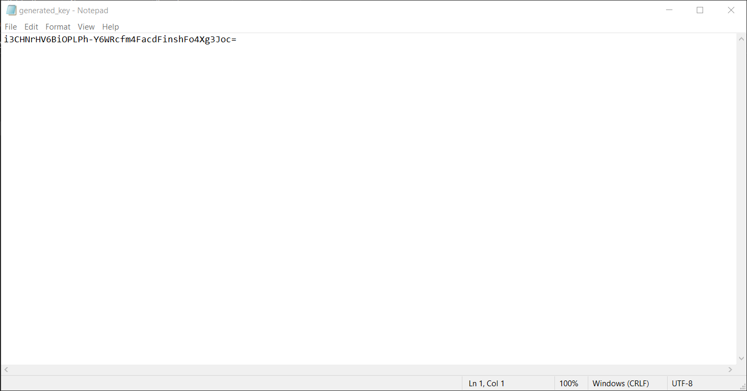
OUTPUT: GENERATED KEY
The Key Generated Would be same: As Long as the Password is same

Slide 18
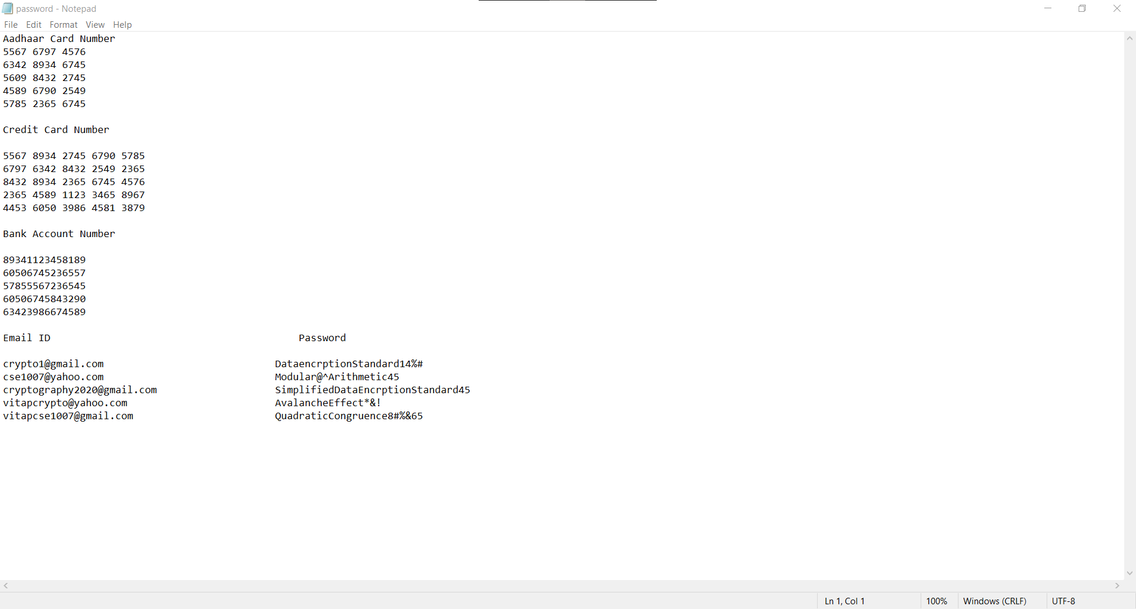
The File We Are Using For Encrypting: “password.txt”

Slide 19
file_encryp.py
import cryptography
from cryptography.fernet import Fernet
# Read the Key From the file
file=open('generated_key.txt','rb')
key=file.read()
file.close()
# Encrypt the File:
# Open The file to Encrypt:
with open('password.txt','rb') as f:
data=f.read()
fernet=Fernet(key)
encrypted=fernet.encrypt(data)
# Writing the Encrypted File
with open('password.txt.encrypted','wb') as f:
f.write(encrypted)

Slide 20
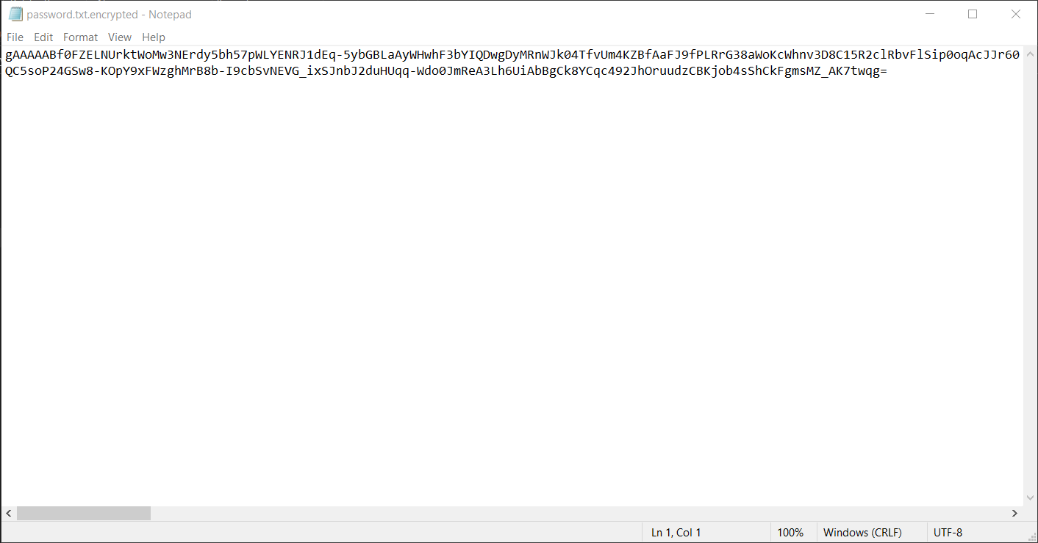
OUTPUT

Slide 21
file_decryp..py
import cryptography
from cryptography.fernet import Fernet
# Read the Key From the file
file=open('generated_key.txt','rb')
key=file.read()
file.close()
# Decrypting the File:
# Open The file to Decrypt:
with open('password.txt.encrypted','rb') as f:
data=f.read()
fernet=Fernet(key)
decrypted=fernet.decrypt(data)
# Writing the Encrypted File
with open('decrypted.txt','wb') as f:
f.write(decrypted)

Slide 22

OUTPUT

Slide 23
CONCLUSION
A set of programs have been created for the purpose of converting a given text file into an encrypted file and then decrypt the encrypted file into the given text file, when needed.
Information threat can be avoided upto some extent, though it is not an industry ready standard. The text file with important details will be secure if we follow the below steps
Generate a key by executing keygen_using_password program. We can enter any value as password for creating the key.
Execute the file_encryp program after mentioning the name of the file to be encrypted. An encrypted file will be created after the execution of this program. We can delete the text file as soon as encrypted file is created. No one can understand the data inside encrypted file so, the information in the file is secure.
When the concern person wants the text file, he/she can execute the file_decryp program. A text file (decrypted file) with all the contents of original text file will be created after the execution of this program.

